Slide 1
Calculation of Dielectric Constants
April 5, 2015

Slide 2
Capacitors
(Infinite) electrically conducting parallel plates separated by vacuum
d
A = area of each plate

Slide 3
Capacitors
(Infinite) electrically conducting parallel plates separated by vacuum
Apply an electric potential difference V = φ₁ - φ₂ across them
φ₁
d
φ₂
A = area of each plate

Slide 4

Capacitors
(Infinite) electrically conducting parallel plates separated by vacuum
Apply an electric potential difference V = φ₁ - φ₂ across them
Charges move into each plate, setting up a simple uniform electric field
φ₁
+
+
+
+
+
+
+
+
+
+
+
+
+
+
d
φ₂
-
-
-
-
-
-
-
-
-
-
-
-
-
-
A = area of each plate

Slide 5
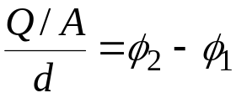

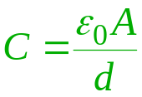
Capacitors
The total charge is proportional to the potential difference
(Infinite) electrically conducting parallel plates separated by vacuum
Apply an electric potential difference V = φ₁ - φ₂ across them
Charges move into each plate, setting up a simple constant electric field
Capacitance
φ₁
+
+
+
+
+
+
+
+
+
+
+
+
+
+
d
φ₂
-
-
-
-
-
-
-
-
-
-
-
-
-
-
A = area of each plate

Slide 6
Dielectrics
A dielectric is another name for an insulator (non-conductor)
Dielectrics can polarize in the presence of an electric field
  distribute charges nonuniformly
Capacitor with a dielectric inside

Slide 7

Dielectrics
A dielectric is another name for an insulator (non-conductor)
Dielectrics can polarize in the presence of an electric field
  distribute charges nonuniformly
Capacitor with a dielectric inside
  dielectric sets up an offsetting distribution of charges when field is turned on
φ₁
+
+
+
+
+
+
+
+
+
+
+
+
+
+
-
-
-
-
-
-
-
+
+
+
+
+
+
+
φ₂
-
-
-
-
-
-
-
-
-
-
-
-
-
-

Slide 8

Dielectrics
A dielectric is another name for an insulator (non-conductor)
Dielectrics can polarize in the presence of an electric field
  distribute charges nonuniformly
Capacitor with a dielectric inside
  dielectric sets up an offsetting distribution of charges when field is turned on
Capacitance is increased
  C = Q/(V/ε) = ε C₀
  same charge on each plate, but potential difference is smaller
  ε is the dielectric constant (ε > 1) (relative permittivity)
_{Q1}
+
+
+
+
+
+
+
+
+
+
+
+
+
+
-
-
-
-
-
-
-
+
+
+
+
+
+
+
_{Q2}
-
-
-
-
-
-
-
-
-
-
-
-
-
-

Slide 9
Some Uses of Dielectric Constant
Solvent dielectric constant correlates with solubility of electrolytes and zwitterions (e.g., pharmaceuticals)
Frequency-dependent dielectric constant ε(ω) determines response to oscillating electric field, and thus optical properties such as index of refraction
Design of capacitors, supercapacitors as an energy storage device
Characterizes of how ionic interactions are attenuated in solution

Slide 10


Polarization
The dielectric in the electric field exhibits a net dipole moment M
Every microscopic point in the
dielectric also will have a
dipole moment
The polarization vector P is the dipole moment per unit volume
  in general, P = P(r)
  for sufficiently small fields, P is proportional to the local E
  this is a key element of linear response theory
-
-
-
-
-
-
-
+
+
+
+
+
+
+
-
-
+
+
-
-
+
+

Slide 11
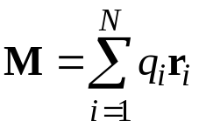
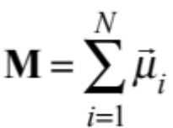
Origins of Polarization
Polarization originates in the electrostatic response of the constituent molecules
In ionic systems, charges migrate
In dipolar systems, molecular dipoles rotate
In apolar systems, dipoles are induced
  “bound charges”
-
+
-
-
+
-
-
-
+
+
+
-
+
-
+
-
-
+
+
+
E
-
+

Slide 12


Polarization Charges
Does polarization imply a nonzero charge density in the dielectric?
  No. For uniform P, the charge inhomogeneities cancel
  But for nonuniform P, there will be a net charge due to polarization
  In general
-
-
-
-
-
-
-
-
-
Zero net charge
+
+
-
-
+
+
-
-
+
+
+
+
+
+
+
+
+
-
-
+
+
-
-
Non-zero net charge
+
+
-
-
+
+
-
+
-
+

Slide 13

Surface Charge
At the dielectric surface, the polarization is discontinuous
  i.e., it is non uniform
  non-zero net charge at surfaces
  charge per unit area is the component of P normal to surface
Relation between physical constants
  dielectric constant ε describes increased capacitance due to surface charges
  electric susceptibility χ describes polarization due to electric field, and which leads to the surface charges
-
-
-
-
-
-
-
-
-
-
-
Net negative charge
+
+
+
+
+
+
+
+
+
+
+
-
-
-
-
-
-
-
-
-
-
-
+
+
+
+
+
+
+
+
+
+
+
-
-
-
-
-
-
-
-
-
-
-
Net positive charge
+
+
+
+
+
+
+
+
+
+
+

Slide 14

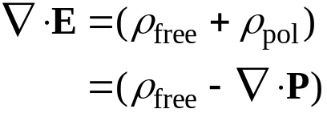
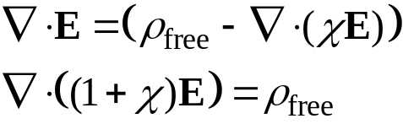

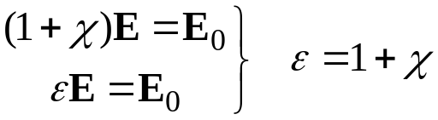
Electrostatic Equations for Dielectrics 1.
Basic electrostatic formula
Separate “free” charges from polarization charges
Apply linear response formula
ρ_{free} relates to the electric field with no dielectric (vacuum)
The relation follows
Note on notation
ε [=] ε₀ ➔ “permittivity”
ε dim’less ➔ “dielectric constant” or “relative permittivity”

Slide 15

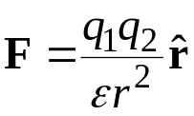

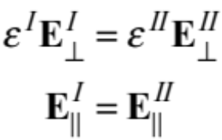
Electrostatic Equations for Dielectrics
Equations are same as in vacuum, but with scaled field
All interactions between “free” charges can be scaled accordingly
  Coulomb’s law in a (linear) dielectric
Dielectric boundaries
  ρ_{free} independent of dielectric
  implies continuity of εE
    but only normal component
constant ε
q₁ and q₂ are free charges
I
II

Slide 16

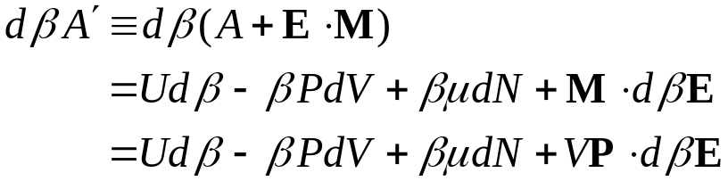
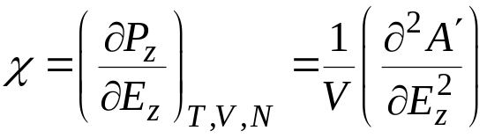
Thermodynamics and Dielectric Phenomena
Fundamental equation in presence of an electric field
  Analogous to mechanical work PΔV, creation of dipole moment M in constant field E requires work E . ΔM = E . M
More convenient to set formalism at constant field E
Electric susceptibility is a 2nd-derivative property
M = total dipole moment
Legendre transform
P = M/V
take z as direction of field

Slide 17
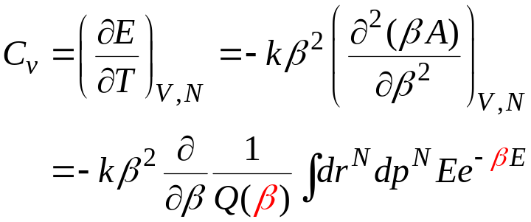

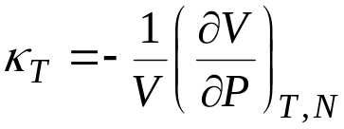
Heat Capacity
Example of a “2nd derivative” property
Expressible in terms of fluctuations of the energy
Other 2nd-derivative or “fluctuation” properties
  isothermal compressibility
Note: difference between two O(N²) quantities to give a quantity of O(N)

Slide 18
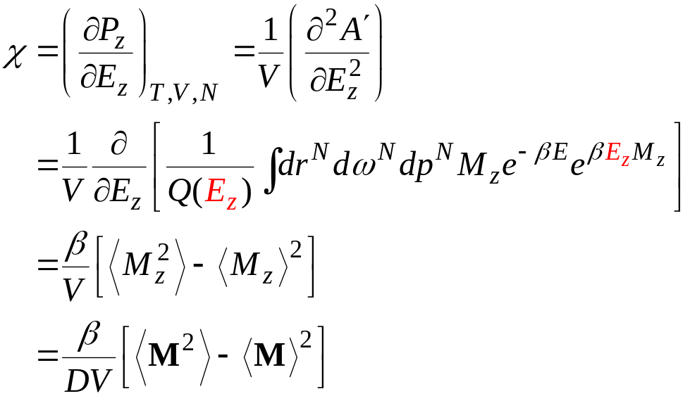
Statistical Mechanics and Dielectric Phenomena
Formula for electric susceptibility
Susceptibility is related to fluctuations in the total dipole moment
  this is sensible, since χ describes how “loose” the charges are, how easily they can appear/orient in response to an external field

Slide 19
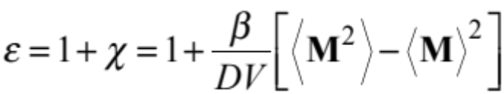

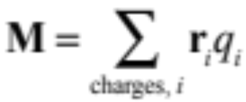
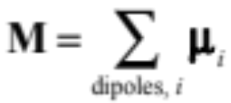
Dielectric Constant from Molecular Simulation
Method 1. Ensemble average of dipole fluctuations
Method 2. Response to an electric field
  Apply field E, measure response P
or

Slide 20
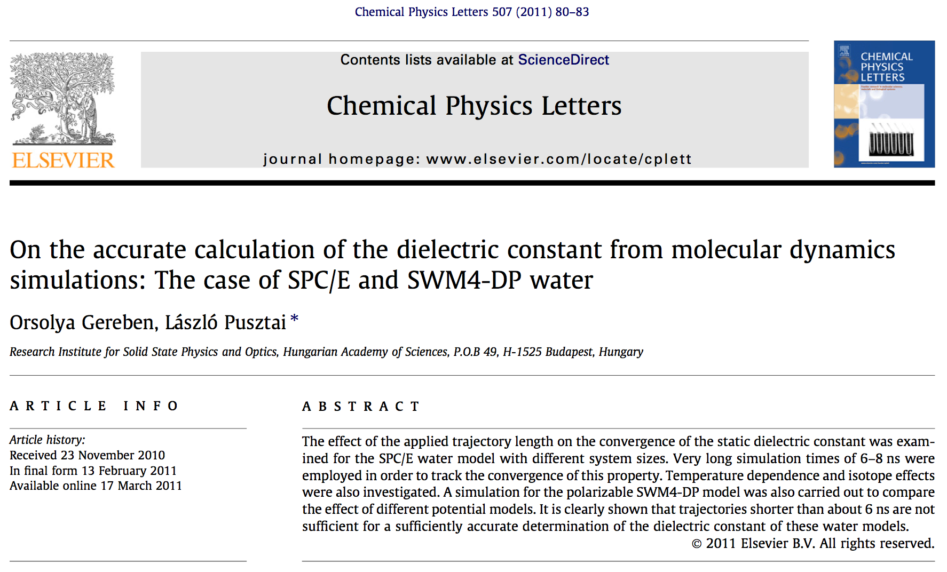
Dielectric Constant from Molecular Simulation
Calculating the dielectric constant is hard

Slide 21
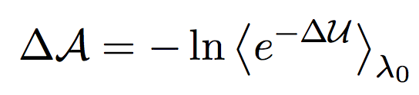




















Targeted Perturbation
Andrew’s idea
Also written by Jarzynski in 2002, but never really used
Improves free-energy perturbation by coupling to displacement (mapping) of coordinates
  Standard FEP
  Introduce Mapping
E₀
E

Slide 22
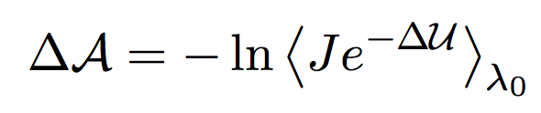


Targeted Perturbation
Revise FEP average
Use energy change with mapping
Jacobian

Slide 23
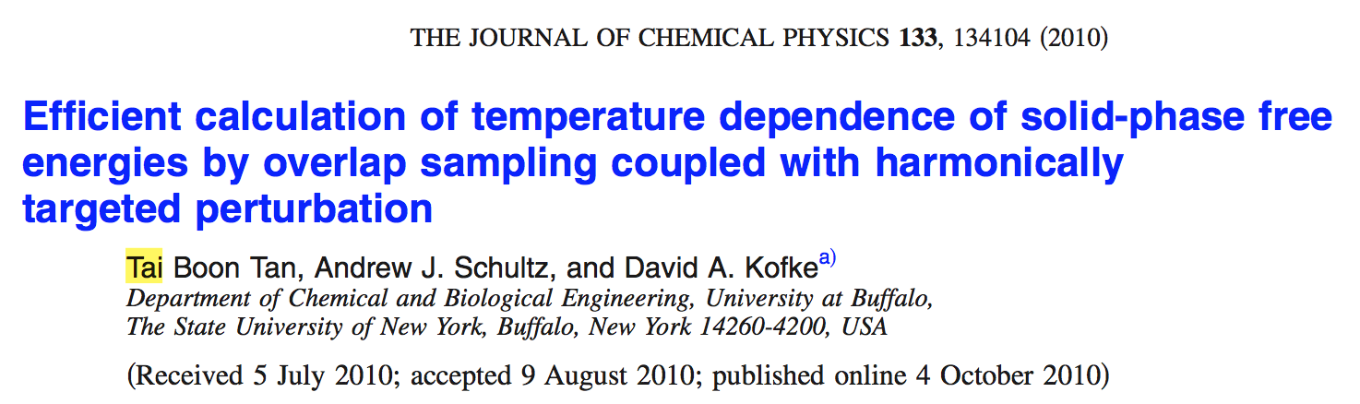
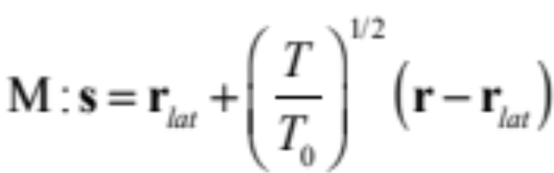
Targeted Perturbation
Application to crystals
  Harmonically targeted temperature perturbation (HTTP)

Slide 24
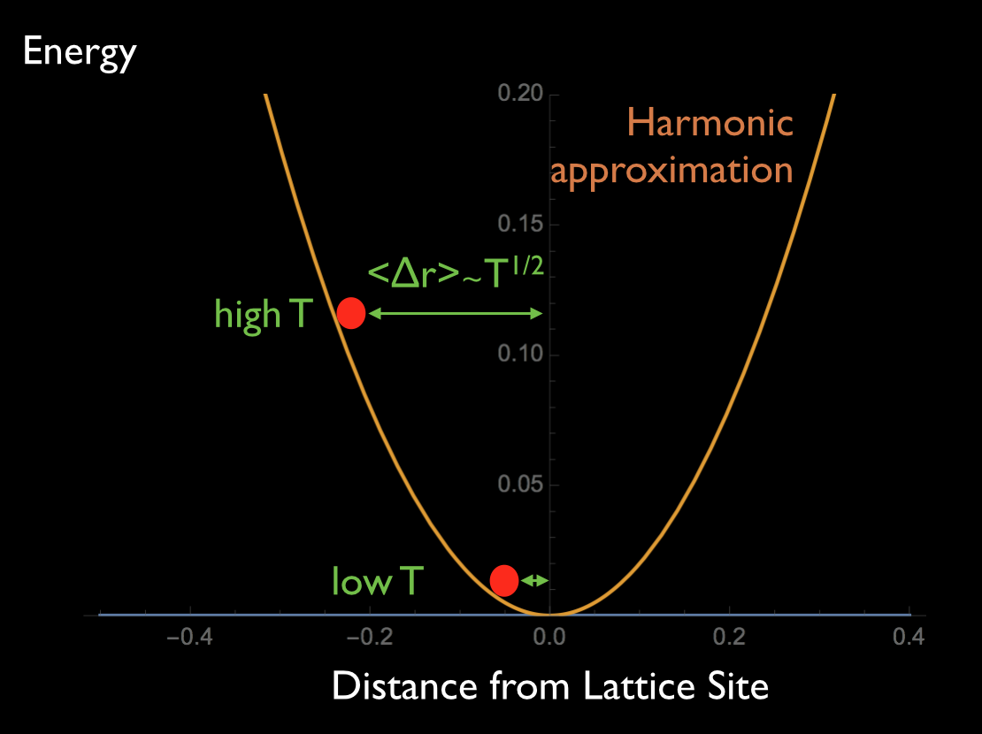
HTTP

Slide 25
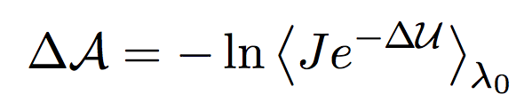
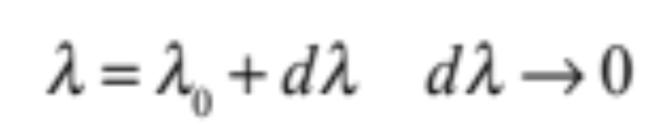
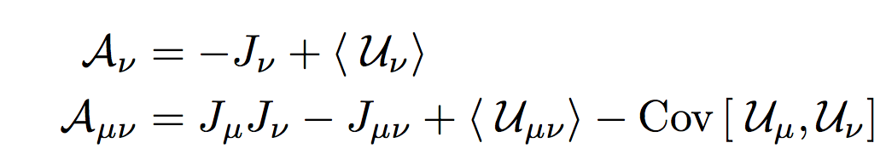
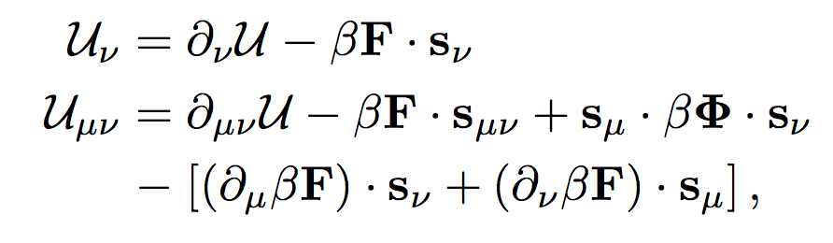
Mapped Averaging
Differential form of targeted perturbation
Free-energy derivatives – thermodynamic properties!

Slide 26
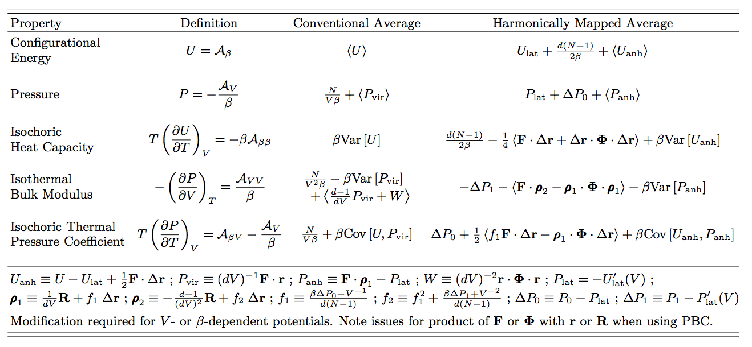
Mapped Averaging
Application to crystals – new ensemble averages for properties

Slide 27
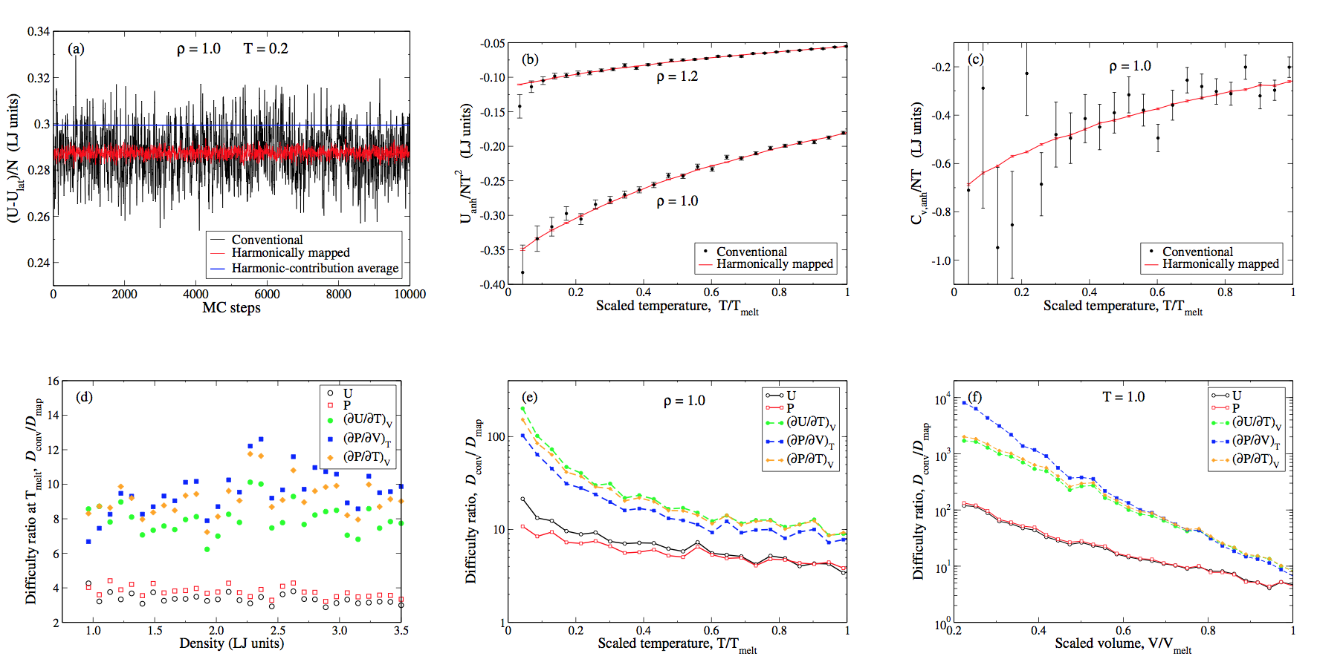
Mapped Averaging
Application to crystals – spectacular results

Slide 28
Statistical Mechanics and Dielectric Phenomena
Formula for electric susceptibility

Slide 29


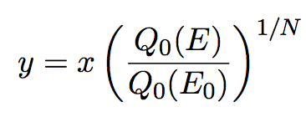
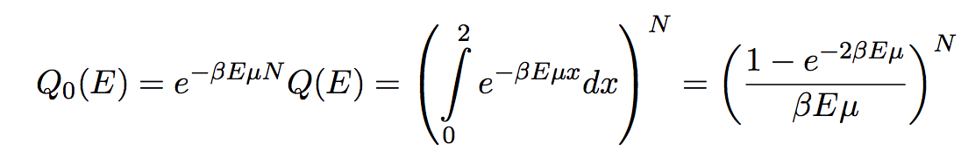
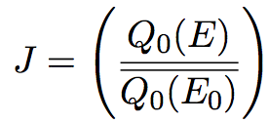
Mapped Average for Dielectric Constant
θ
Coordinate
Mapping
Non-interacting partition function, U = 0 minimum energy
Jacobian
E
x = 0 x = 2

Slide 30
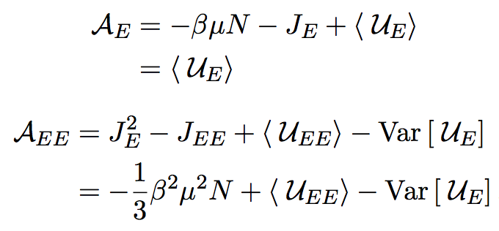
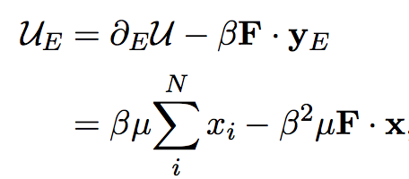
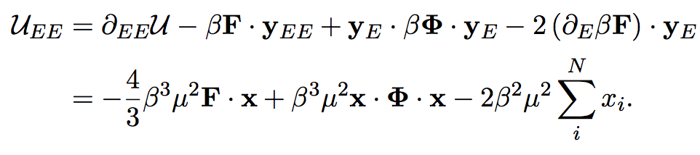
Mapped Average for Dielectric Constant
Working formulas
Next step: try them out!

Slide 31


Slide 32
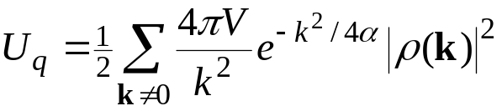
Connection to Ewald Sum
Surface charges on dielectric produce a non-negligible electric field throughout
  Local regions inside dielectric feel this field, even though they have no polarization charge
  Surface charges arise when the system has uniform polarization
    dipole moment per unit volume
In simulation of polar systems, at any instant the system will exhibit an instantaneous dipole
  This dipole is replicated to infinity
  But in principle it stops at some surface
  Should the resulting field influence the simulated system?
  The boundary conditions at infinity are relevant!
-
-
-
-
-
-
-
+
+
+
+
+
+
+
-
+
-
+
-
+
-
+
-
+
-
+
-
+
-
+
-
+
-
+
-
-
-
-
-
+
+
+
+
+
-
+
-
+
-
+
-
+
-
+
-
+
-
+
-
+
-
+
-
+
-
-
-
-
-
+
+
+
+
+
-
+
-
+
-
+
-
+
-
+
-
+
-
+
-
+
-
+
-
+
-
-
-
-
-
+
+
+
+
+
-
+
-
+
-
+
-
+
-
+
-
+
-
+
-
+
-
+
-
+
-
-
-
-
-
+
+
+
+
+
-
+
-
+
-
+
-
+
-
+
-
+
-
+
-
+
-
+
-
+
-
-
-
-
-
+
+
+
+
+
k = 0 term corresponds to this effect

Slide 33

Boundary Conditions for Ewald Sum
Consider the simulated system embedded in a continuum dielectric
-
+
-
+
-
+
-
+
-
+
-
+
-
-
+
-
-
+
-
-
+
-
-
+
-
-
+
+
-
+
+
-
+
+
-
+
+
-
+
+
-
+
+
-
+
-
+
-
-
+
-
-
+
-
-
+
-
-
+
-
-
+
-
-
-
-
+
+
-
+
+
-
+
+
-
+
+
-
+
+
-
+
+
-
+
+
-
+
+
+
-
+
-
+
-
-
+
-
-
+
-
-
+
-
-
+
-
-
+
-
-
+
-
-
-
-
-
+
-
+
+
-
+
+
-
+
+
-
+
+
-
+
+
-
+
+
-
+
+
-
+
+
-
+
+
+
-
+
+
+
-
+
-
-
-
+
-
-
+
-
-
+
-
-
+
-
-
+
-
-
+
-
-
+
-
-
-
-
-
-
-
+
-
+
+
-
+
+
-
+
+
-
+
+
-
+
+
-
+
+
-
+
+
-
+
+
-
+
+
-
+
+
+
-
+
+
+
-
+
+
+
-
+
-
-
-
+
-
-
+
-
-
+
-
-
+
-
-
+
-
-
+
-
-
+
-
-
+
-
-
-
-
-
-
-
-
-
-
+
-
+
-
+
-
+
-
+
-
+
-
+
-
+
-
+
-
-
+
-
+
-
+
-
+
-
-
+
+
-
+
+
-
+
+
-
+
+
-
+
+
-
+
+
-
+
+
-
+
+
-
+
+
-
+
+
-
+
-
+
-
+
+
-
+
+
-
+
+
-
+
+
+
-
+
-
+
-
+
-
+
-
+
-
+
-
+
-
+
-
+
-
+
-
+
-
-
+
-
-
+
-
+
-
-
+
-
+
-
+
-
+
-
+
-
+
-
+
-
+
-
+
-
+
+
+
+
+
+
+
+
-
+
+
-
+
-
+
-
-
+
-
-
+
-
-
+
-
-
+
-
-
+
-
-
+
-
-
+
-
-
+
-
-
+
-
-
-
-
-
-
-
-
-
-
-
+
-
+
+
-
+
+
-
+
+
-
+
+
-
+
+
-
+
+
-
+
+
-
+
+
-
+
+
-
+
+
-
+
+
-
+
+
-
+
+
-
+
+
-
+
-
+
-
-
+
-
-
+
-
-
+
-
-
+
-
-
+
-
-
+
-
-
+
-
-
+
-
-
+
-
-
+
-
-
+
-
-
+
-
-
+
-
-
+
-
+
-
+
+
-
+
+
-
+
+
-
+
+
-
+
+
-
+
+
-
+
+
-
+
+
-
+
+
-
+
+
-
+
+
-
+
+
-
+
+
-
+
+
-
+
-
+
-
-
+
-
-
+
-
-
+
-
-
+
-
-
+
-
-
+
-
-
+
-
-
+
-
-
+
-
-
+
-
-
+
-
-
+
-
-
+
-
-
+
-
+
+
+
+
+
+
-
+
-
+
-
+
-
+
-
+
+
+
+
+
+
+
+
+
+
-
+
-
+
-
+
-
-
+
+
-
+
+
-
+
+
-
+
+
-
+
+
-
-
-
-
-
-
-
-
-
+
-
+
-
+
-
+
-
+
-
+
-
+
-
+
+
-
-
+
-
-
+
-
-
+
-
+
-
+
-
+
+
-
+
+
-
+
+
-
+
+
-
+
-
+
-
-
+
+
-
+
+
-
+
+
-
+
-
+
-
+
-
+
-
+
-
+
-
+
-
+
-
+
-
+
-
+
-
+
-
+
+
-
+
-
+
-
+
-
+
-
+
-
+
-
+
-
+
-
+
-
+
-
+
+
-
+
-
+
-
+
-
+
-
+
+
+
-
+
-
+
-
+
-
+
-
+
-
-
+
-
-
+
-
-
+
-
-
+
-
+
-
+
-
+
-
+
-
-
+
-
+
-
+
+
-
+
+
-
+
+
-
+
+
-
+
-
+
-
-
+
-
+
-
+
-
-
+
-
-
+
-
-
+
-
-
+
-
+
-
+
-
-
+
+
+
+
+
-

Slide 34

Boundary Conditions for Ewald Sum
Consider the simulated system embedded in a continuum dielectric
An instantaneous dipole fluctuation occurs often during the simulation

Slide 35

Boundary Conditions for Ewald Sum
Consider the simulated system embedded in a continuum dielectric
An instantaneous dipole fluctuation occurs often during the simulation
The polarization creates a surface charge, and field E
-
-
-
-
-
-
-
-
+
+
+
+
+
+
+
+
+

Slide 36
Boundary Conditions for Ewald Sum
Consider the simulated system embedded in a continuum dielectric
An instantaneous dipole fluctuation occurs often during the simulation
The polarization creates a surface charge, and field E
The dielectric responds with a counter charge distribution
+
+
+
+
-
-
+
+
-
-
+
-
+
+
-
-
-
+
+
-
-
+
+
+
+
-
-
+
+
+
-
-
-
-

Slide 37
Boundary Conditions for Ewald Sum
Consider the simulated system embedded in a continuum dielectric
An instantaneous dipole fluctuation occurs often during the simulation
The polarization creates a surface charge , and field E
The dielectric responds with a surface charge distribution
This produces a depolarizing field that attenuates the surface-charge field
+
+
+
+
-
-
+
+
-
-
+
-
+
+
-
-
-
+
+
-
-
+
+
+
+
-
-
+
+
+
-
-
-
-

Slide 38
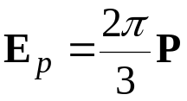
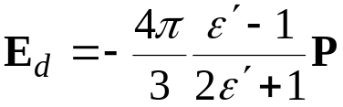
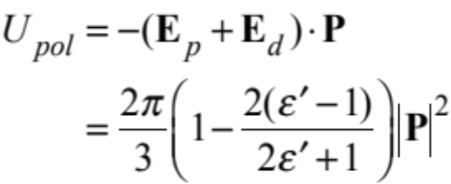

Boundary Contribution to Hamiltonian
The field due to the surface charge is
The depolarizing field from the dielectric is
The contribution to the system energy (Hamiltonian) from its interaction with these fields is
Common practice is to use conducting boundary, ε' = ∞
complicated by spherical geometry
Both effects cancel, and we can use the Ewald formula as derived

Slide 39

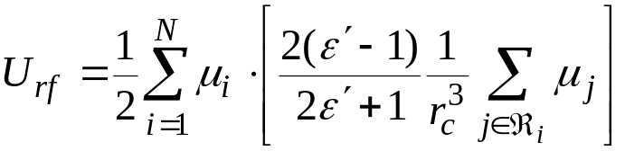
Reaction Field Method
Alternative to Ewald sum for treatment of long-range electrostatic interactions
Define interaction sphere ℜ for each particle
Direct interactions with other particles in ℜ
Treat material outside sphere as continuum dielectric
  Dielectric responds to instantaneous dipole
  inside sphere
  Contributes to energy as described before
  Aim to make ε' = ε (results not sensitive to choice)
-
+
+
-
-
+

